Slide 1

CONTINUOUS SYSTEM

Slide 2
CONTINUOUS SYSTEM
QUESTION - 2
In a pure pursuit problem, there is a target, which moves along a predetermined path, and there is a pursuer who follows the target, redirecting itself towards the target at fixed intervals of time. A fighter aircraft following an enemy bomber is an example of pure pursuit problem. The fighter corrects its direction after a fixed interval of 1 minute. The fighter’s speed S is constant at 20km/min, while the target’s path is specified as a function of time as below:
time(t) | 0 | 1 | 2 | 3 | 4 | 5 | 6 | 7 | 8 | 9 | 10 | 11 | 12 | 13 | 14 | 15
xb(t) | 100 | 110 | 120 | 129 | 140 | 149 | 158 | 168 | 179 | 188 | 198 | 209 | 219 | 226 | 234 | 240
yb(t) | 0 | 3 | 6 | 10 | 15 | 20 | 26 | 32 | 37 | 34 | 30 | 27 | 23 | 19 | 16 | 14
Initially the fighter’s position is at (xf,yf) = (0,60) and the bomber’s position is at (xb,yb) = (100,0). If the distance turns within 10 km or less within 12 minutes, the pursuit ends, otherwise the bomber escapes and the pursuit is abandoned. Now, find whether the fighter is able to destroy the bomber or not. If the fighter succeeds in destroying then at what distance and time?

Slide 3
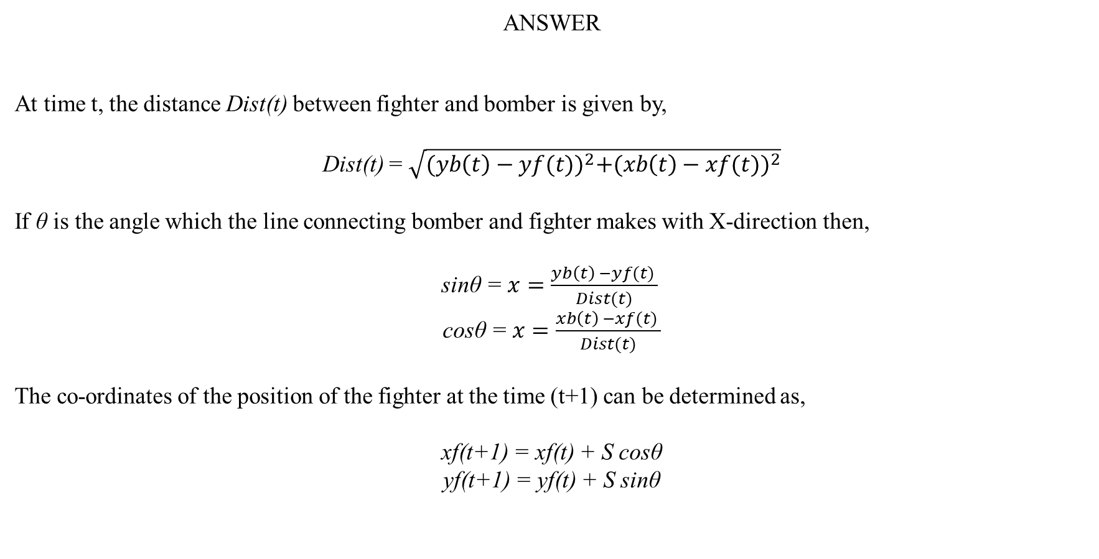
CONTINUOUS SYSTEM
ANSWER
At time t, the distance Dist(t) between fighter and bomber is given by,
Dist(t) = $\sqrt{{(yb\left(t\right)−yf(t))}^{2}+{(xb\left(t\right)−xf(t))}^{2}}$
If θ is the angle which the line connecting bomber and fighter makes with X-direction then,
sinθ = $x=\frac{yb\left(t\right) −yf(t) }{Dist(t)}$
cosθ = $x=\frac{xb\left(t\right) −xf(t) }{Dist(t)}$
The co-ordinates of the position of the fighter at the time (t+1) can be determined as,
xf(t+1) = xf(t) + S cosθ
yf(t+1) = yf(t) + S sinθ

Slide 4
CONTINUOUS SYSTEM
time | 0 | 1 | 2 | 3 | 4 | 5 | 6 | 7 | 8 | 9 | 10
yb(t) | 0 | 3 | 6 | 10 | 15 | 20 | 26 | 32 | 37 | 34 | 30
yf(t) | 60 | 49.710 | 40.722 | 33.158 | 27.291 | 23.700 | 22.397 | 23.968 | 28.349 | 34.398 | 33.935
xb(t) | 100 | 110 | 120 | 129 | 140 | 149 | 158 | 168 | 179 | 188 | 198
xf(t) | 0 | 17.149 | 35.016 | 53.531 | 72.651 | 92.326 | 112.283 | 132.222 | 151.736 | 170.799 | 190.794
Dist(t) | 116.619 | 103.937 | 91.803 | 78.942 | 68.461 | 56.794 | 45.858 | 36.669 | 28.604 | 17.205 | 8.210
sinθ | -0.514 | -0.449 | -0.378 | -0.293 | -0.179 | -0.065 | 0.079 | 0.219 | 0.302 | -0.023
cosθ | 0.857 | 0.893 | 0.926 | 0.956 | 0.984 | 0.998 | 0.997 | 0.976 | 0.953 | 0.999
The fighter is able to destroy the bomber at 10 minutes when the distance between them is 8.210 km

